Slide 1
Portfolio Optimization
Lecture 5
Robert Kissell
Fall 2017

Slide 2
Lecture 8: Portfolio Optimization with TCA
Lecture:
Review of Homework Problems
Neural Network – Machine Learning
Traditional QP Optimization
Efficient Frontier
Optimization
Final Project Problem
Final Project Due Friday 12/15/2017

Slide 3
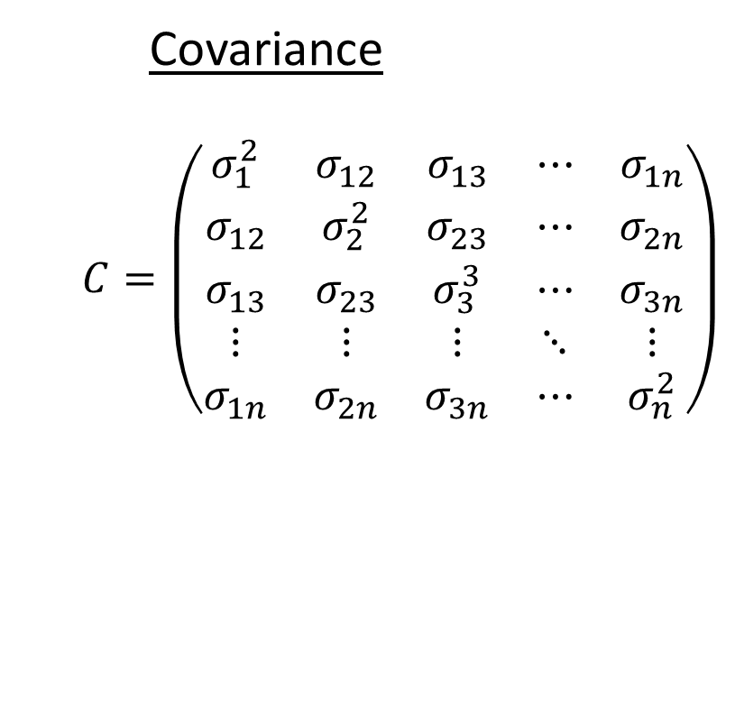

Mathematical Notations
Weights Return
$$w=\left(\begin{matrix}w_{1} \\ w_{2} \\ w_{3} \\ ⋮ \\ w_{n}\end{matrix}\right) R=\left(\begin{matrix}r_{1} \\ r_{2} \\ r_{3} \\ ⋮ \\ r_{n}\end{matrix}\right)$$
Covariance
$$C=\left(\begin{matrix}σ_{1}^{2} & σ_{12} & σ_{13} & ⋯ & σ_{1n} \\ σ_{12} & σ_{2}^{2} & σ_{23} & ⋯ & σ_{2n} \\ σ_{13} & σ_{23} & σ_{3}^{3} & ⋯ & σ_{3n} \\ ⋮ & ⋮ & ⋮ & ⋱ & ⋮ \\ σ_{1n} & σ_{2n} & σ_{3n} & ⋯ & σ_{n}^{2}\end{matrix}\right)$$

Slide 4

Mathematical Formulas - Portfolio Calculations
Return
$$w^{′}R=\sum_{i=1}^{n}{w_{i}r_{i}}{=w}_{1}r_{1}+w_{2}r_{2}+…+w_{n}r_{n}$$
Risk:
$$w^{′}Cw=\sum_{i=1}^{n}{\sum_{j=1}^{n}{w_{i}w_{j}}σ_{ij}}$$
$$σ_{ii}=σ_{i}^{2}; w_{i}w_{i}=w_{i}^{2}$$
$$w^{′}\underset{3x3}{C}w=w_{1}^{2}σ_{1}^{2}+w_{2}^{2}σ_{2}^{2}+w_{3}^{2}σ_{3}^{2}+2∙w_{1}w_{2}σ_{12}…$$
$$+2w_{1}w_{3}σ_{13}+2w_{2}w_{3}σ_{23}$$

Slide 5
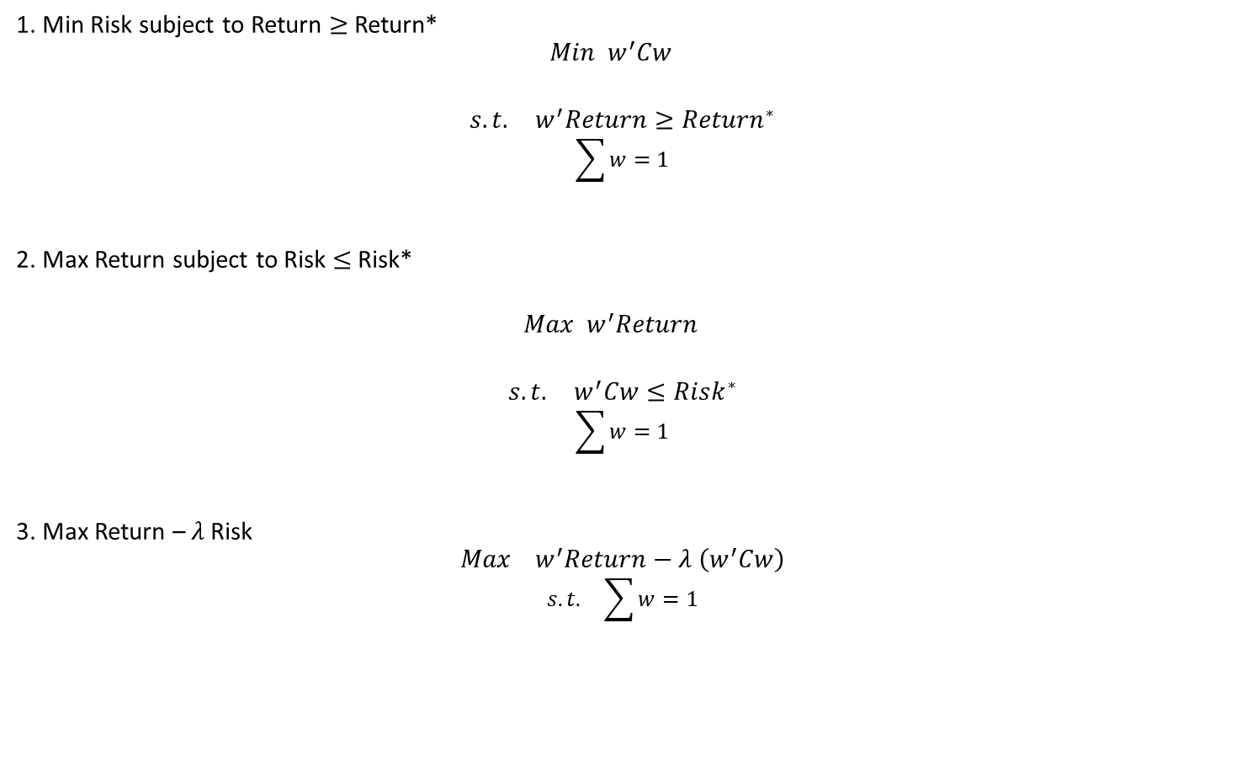
Traditional Portfolio Optimization
1. Min Risk subject to Return $≥$ Return*
$$Min w^{′}Cw$$
$$s.t. w^{′}Return≥{Return}^{∗}$$
$$\sum{w}=1$$
2. Max Return subject to Risk $≤$Risk*
$$Max w^{′}Return$$
$$s.t. w^{′}Cw≤Risk^{∗}$$
$$\sum{w}=1$$
3. Max Return – $λ$Risk
$$Max w^{′}Return−λ \left(w^{′}Cw\right)$$
$$s.t. \sum{w}=1$$

Slide 6
Portfolio Optimization – Ten (10) Stock Example

Slide 7
Set of Random Portfolios

Slide 8
Efficient Frontier

Slide 9
Efficient Frontier – Rational / Efficient Strategies

Slide 10
Efficient Frontier Would you every select an Inefficient / Irrational Strategy?

Slide 11
Net Returns: After Adjusting for Trading Costs (Market Impact)

